Slide 1
Test Automation
Felipe Carvalho
Leonardo Nelson
21/05/2018

Slide 2
Behavior Driven Development - BDD
JBehave
REST API Testing
Front-End Testing

Slide 3
Behavior Driven Development

Slide 4
A Little of Context ...
Requirements: Classic Methodologies vs Agile Methodologies

Slide 5
Classic Methodologies
Requirement Analysis as a discipline
Aims to know and understand the customer needs
Activities: Discover, Analyse and document the requirements
Comprehensive Documentation
Techniques: Interviews with the stakeholders, requirement workshops, lists, prototypes, business use cases

Slide 6
Classic Methodologies

Slide 7
Issues
Users do not know exactly what they really want
Attempt to adapt a new system to a common standard or model instead of building something that meets the customer needs
The communication tends to be slow
The customer is involved usually at the beginning and at the end of the development process
Business users and Technical staff have a different vocabulary

Slide 8
Agile: Software that matters!
“Customer satisfaction through early and continuous software delivery”
(Agile Manifesto, 2001)

Slide 9
Agile Methodologies
Requirements
Meetings for scope definition (high-level approach)
User Stories
Requirement changes are normal and acceptable
Describe just the enough to develop the requirement and check often with the customer if it is right
Constant feedback from the customers
Deliver value to the customers, deliver software that really matters.

Slide 10
Issues
Attempt to adapt a new system to a common standard or model instead of building something that meets the customer needs
The communication tends to be slow
The customer is involved usually at the beginning and at the end of the development process
Business users and Technical staff have a different vocabulary

Slide 11
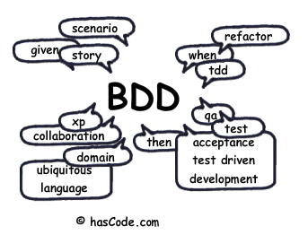
Behavior Driven Development
“You can't write good software if you don't understand what it's supposed to do.”
John Ferguson Smart - BDD In Action
Notes:
Content Slide: This is usually the most frequently used slide in every presentation.
Use this slide for Text heavy slides. Text can only be used in bullet points
Title Heading – font size 30, Arial Heading
Slide Content – Should not reduce beyond Arial body font 16
If you need to use sub bullets please use the indent buttons located next to the bullets buttons in the tool bar and this will automatically provide you with the second, third, fourth & fifth level bullet styles and font sizes
Please note you can also press the tab key to create the different levels of bulleted content

Slide 12
So what is BDD?
BDD stands for Behavior Driven Development
It is a set of agile practices and techniques that aim the enhancement of the collaboration and communication in the software development teams
Focus on the language and interactions during the software development process

Slide 13
What BDD is not ...
BDD is not a software development methodology
It is not a substitute for Scrum, XP, Kanban, RUP or any methodology / framework you are using for developing your software

Slide 14
History
Created in 2003 by Dan North, consultant specialist in agile methodologies (ThoughWorks)
It came up from observations and ideas from agile practices such as Scrum, Lean, TDD and DDD
Initially, it was a response to TDD technique (which focus on the technical aspect of the software)

Slide 15
BDD Benefits
Encourage the team to develop, use and share a common understanding of how and why the application should work
Define features that focus your development efforts on underlying business goals (software that matters!)

Slide 16
BDD Benefits
Enhancement of the language and the interactions during the development process
It allows the developers to undestand better the reasons the code should be created and not just the technical details
It reduces the constant translations between the business language and technical language, everyone should be in the same page (users, developers, testers, PO, Managers)

Slide 17
BDD Techniques
To achieve this, BDD introduces some techniques that should be integrated with the development process:
Specification using scenarios/examples
Usage of a Ubiquitous Language
Usage of “should” and “ensureThat” to describe behavior
Automated Examples for fast feedback (acceptance tests)
Outside-In Development

Slide 18
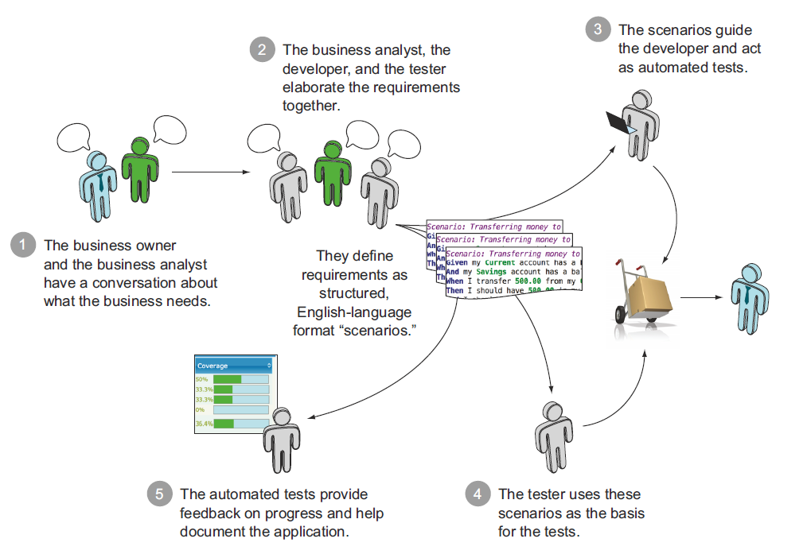
BDD Workflow

Slide 19
Specification Using Examples
Requirements written in a conventional way are highly susceptible to ambiguities, assumptions, and misunderstandings

Slide 20
Specification Using Examples
Write acceptance criterias (AC) for the User Stories using scenarios and examples to describe the expected feature behavior
Establishes in a clear way what should be developed and tested
Extremely effective way to communicate requirements in a precise, clear and unambiguous manner

Slide 21
Specification Using Examples
Story: ATM Withdraw
Narrative:
In order to get money from my banking account
As a customer
I want to perform a withdraw
Scenario: The withdrawal value should be debited from the customer’s current balance
Given an active customer with the id 9999
And his account has a balance of $2000.00
When the customer withdraws $500.00
Then the withdrawal should be completed successfully
And the new balance should be $1500.00

Slide 22
Specification Using Examples
Keywords
Story (Feature)
As a
I want so that
Scenario (Acceptance Criteria)
Given
When
Then

Slide 23
Specification Using Examples
Its strength is that it forces you to identify the value of delivering a story when you first define it. When there is no real business value for a story, it often comes down to something like ” . . . I want [some feature] so that [I just do, ok?].” This can make it easier to descope some of the more esoteric requirements. (Dan North)
A story’s behaviour is simply its acceptance criteria – if the system fulfills all the acceptance criteria, it’s behaving correctly; if it doesn’t, it isn’t.

Slide 24
The “Should” word
It encourages to question whether the behavior described is appropriate, or whether they can be moved or removed entirely
Then the withdraw should be completed successfully
And the new balance should be $1500.00

Slide 25
Ubiquitous Language
It aims to define a shared domain language that can be understood either by the customers and developers, so they can talk in the same language
Eric Evans published his bestselling book Domain-Driven Design that describes the concept of modeling a system using a ubiquitous language based on the business domain, so that the business vocabulary permeates right into the codebase.
So Dan North realized that BDD provides an Ubiquotous Language for the analysis process itself

Slide 26
Outside-In Development
BDD is guided by the business values. These values are noticed by the users through the user interface (usually, but not always the GUI)
All features should be developed from the interface (UI) perspective and then evolved to the other application modules (services, domain, database)
Once having the UI in place, all the other application modules can be developed as its clients

Slide 27
Automated Examples
In BDD the acceptance criteria can be easily automated from the stories and scenarios
Provides Live Documentation, regression tests and fast feedback on the quality (CI)
Tools like Jbehave, Cucumber, Serenity BDD, Rspec (Ruby), Jasmine (JavaScript) can be used to easily automate them and allow the specification to be executed

Slide 28
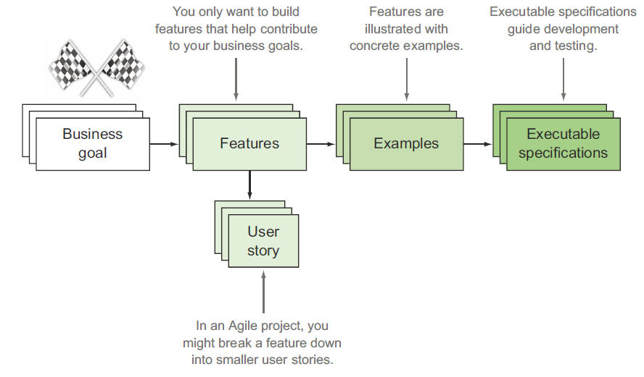

Automated Examples

Slide 29
Hands-on
Complete the exercise 1
Notes:
Content Slide: This is usually the most frequently used slide in every presentation.
Use this slide for Text heavy slides. Text can only be used in bullet points
Title Heading – font size 30, Arial Heading
Slide Content – Should not reduce beyond Arial body font 16
If you need to use sub bullets please use the indent buttons located next to the bullets buttons in the tool bar and this will automatically provide you with the second, third, fourth & fifth level bullet styles and font sizes
Please note you can also press the tab key to create the different levels of bulleted content

Slide 30
JBehave

Slide 31
What is JBehave?
JBehave is an open-source JAVA based Framework for Behavior Driven Development (BDD). It intends to make the BDD more accessible and intuitive, shifting the vocabulary from test-based to behavior-based.
Notes:
Content Slide: This is usually the most frequently used slide in every presentation.
Use this slide for Text heavy slides. Text can only be used in bullet points
Title Heading – font size 30, Arial Heading
Slide Content – Should not reduce beyond Arial body font 16
If you need to use sub bullets please use the indent buttons located next to the bullets buttons in the tool bar and this will automatically provide you with the second, third, fourth & fifth level bullet styles and font sizes
Please note you can also press the tab key to create the different levels of bulleted content

Slide 32
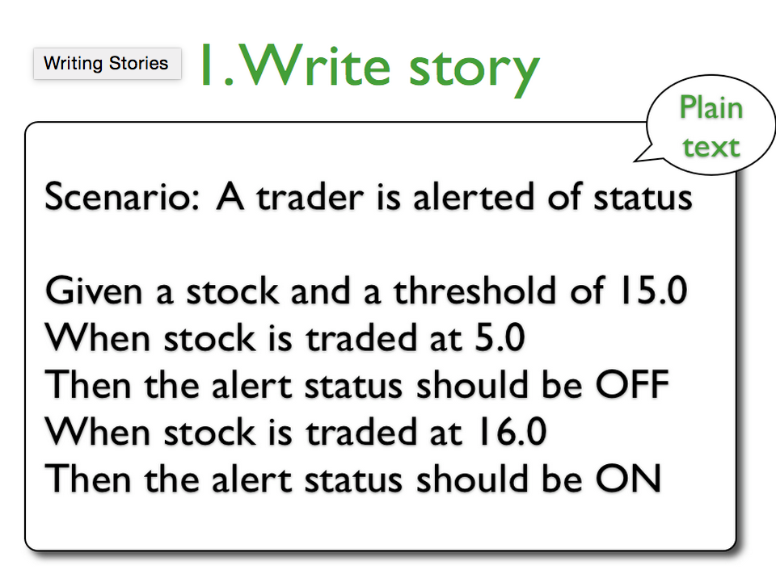
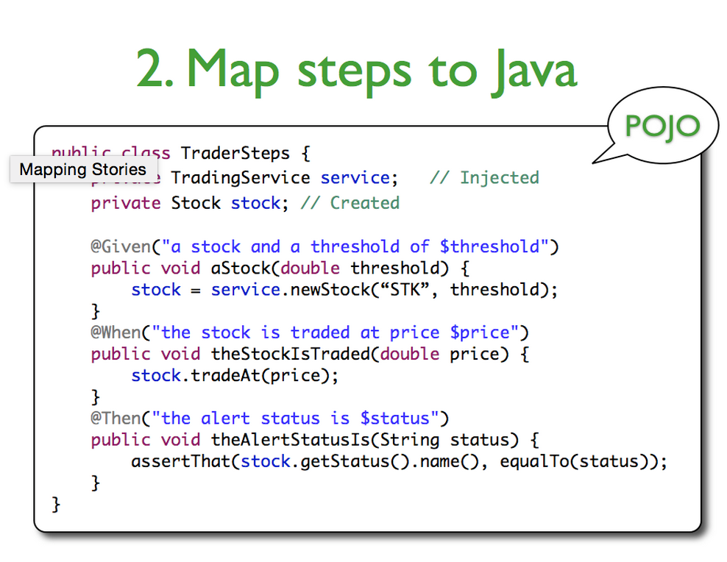
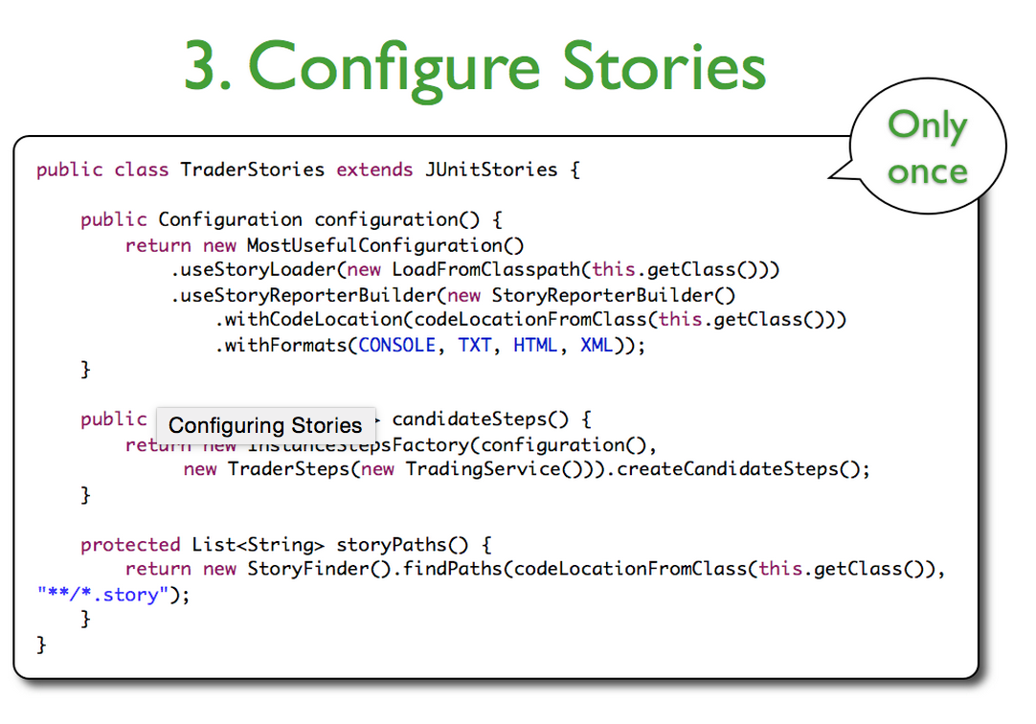

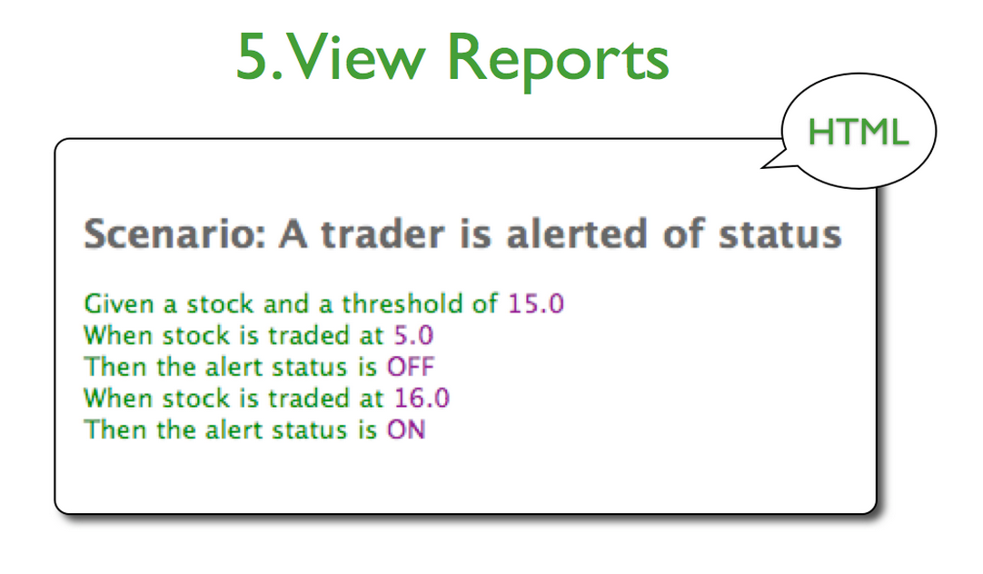
What is JBehave?
32
Notes:
Content Slide: This is usually the most frequently used slide in every presentation.
Use this slide for Text heavy slides. Text can only be used in bullet points
Title Heading – font size 30, Arial Heading
Slide Content – Should not reduce beyond Arial body font 16
If you need to use sub bullets please use the indent buttons located next to the bullets buttons in the tool bar and this will automatically provide you with the second, third, fourth & fifth level bullet styles and font sizes
Please note you can also press the tab key to create the different levels of bulleted content

Slide 33
Writing Stories Using JBehave
Based on BDD, each story should be broken up in scenarios.
A story is a collection of scenarios, and these scenarios consist of a collection of steps.
Stories should be written using the business language, and avoid as much as possible to use technical details.
Notes:
Content Slide: This is usually the most frequently used slide in every presentation.
Use this slide for Text heavy slides. Text can only be used in bullet points
Title Heading – font size 30, Arial Heading
Slide Content – Should not reduce beyond Arial body font 16
If you need to use sub bullets please use the indent buttons located next to the bullets buttons in the tool bar and this will automatically provide you with the second, third, fourth & fifth level bullet styles and font sizes
Please note you can also press the tab key to create the different levels of bulleted content

Slide 34
Story File Structure
Narrative:
As a Test Automation User
I want to perform a search on a Search Engine Page
So that I can see my search results
Scenario: I can perform a search on Search Engine Page
Given I am on Search Engine Home Page
When I perform a search with text <criteriaText>
Then The results of my search are displayed
Examples:
|criteriaText |
|Test Automation|
Narrative
Scenario
Notes:
Column content slide
This is a slide with 2 columns and you can have text in bullet points under each column. You can have separate header for each of the columns in the blue box provided on top of each of the columns.
Heading font size of the column should remain at 30 and the column content font size should not reduce beyond 16.

Slide 35
Story File Structure
Narrative: Gives a brief description of the story, what operation(s) is/are going to be tested.
Scenario:
Given: Pre-conditions expected for the scenario execution. When: Interactions on the application, may be a user interaction or even a system internal interaction, normally is when function or features are executed through the system.
Then: Test validations. Here you will verify if the application have worked as expected.
Notes:
Content Slide: This is usually the most frequently used slide in every presentation.
Use this slide for Text heavy slides. Text can only be used in bullet points
Title Heading – font size 30, Arial Heading
Slide Content – Should not reduce beyond Arial body font 16
If you need to use sub bullets please use the indent buttons located next to the bullets buttons in the tool bar and this will automatically provide you with the second, third, fourth & fifth level bullet styles and font sizes
Please note you can also press the tab key to create the different levels of bulleted content

Slide 36
Step Definition
JBehave centers around the matching of textual steps with Java methods contained in steps instances.
Each annotated method in the steps instances corresponds to a StepCandidate, which is responsible for the matching and for the creation of an executable step.
@Component
public class SearchSteps {
@Autowired
SearchPage searchPage;
@Autowired
SearchResultPage searchResultPage;
@Given (“I am on Search Engine Home Page”)
public void navigateToSearchPage () {
searchPage.navigateTo();
}
@When (“I perform a search with text $criteriaText”)
public void performSearch (@Named(“criteriaText”) String criteriaText) {
searchPage.typeSearchCriteria( criteriaText );
searchPage.performSearch();
}
@Then (“The results of my search are displayed”)
public void checkSearchResults () {
Assert.assertTrue( searchResultPage.getResults() > 0 );
}
}
Notes:
Column content slide
This is a slide with 2 columns and you can have text in bullet points under each column. You can have separate header for each of the columns in the blue box provided on top of each of the columns.
Heading font size of the column should remain at 30 and the column content font size should not reduce beyond 16.

Slide 37
Step Parameters
Standalone parameter:
Java Step definition
@When("I perform a search with text $criteriaText”)
public void performSearch(@Named("criteriaText") String criteriaText) {
searchPage.typeSearchCriteria(criteriaText);
searchPage..performSearch();
}
Story file step call
When I perform a search with text Test Automation
Notes:
Content Slide: This is usually the most frequently used slide in every presentation.
Use this slide for Text heavy slides. Text can only be used in bullet points
Title Heading – font size 30, Arial Heading
Slide Content – Should not reduce beyond Arial body font 16
If you need to use sub bullets please use the indent buttons located next to the bullets buttons in the tool bar and this will automatically provide you with the second, third, fourth & fifth level bullet styles and font sizes
Please note you can also press the tab key to create the different levels of bulleted content

Slide 38
Step Parameters
Examples Table
Java Step definition
@When("I perform a search with text <criteriaText>”)
public void performSearch(@Named("criteriaText") String criteriaText) {
searchPage.getSearchComponent().typeSearchCriteria(criteriaText);
searchPage.getSearchComponent().performSearch();
}
Story file step call
When I perform a search with text <searchCriteria>
Examples:
|searchCriteria |
|Test Automation |
|Software Engineer|
Notes:
Content Slide: This is usually the most frequently used slide in every presentation.
Use this slide for Text heavy slides. Text can only be used in bullet points
Title Heading – font size 30, Arial Heading
Slide Content – Should not reduce beyond Arial body font 16
If you need to use sub bullets please use the indent buttons located next to the bullets buttons in the tool bar and this will automatically provide you with the second, third, fourth & fifth level bullet styles and font sizes
Please note you can also press the tab key to create the different levels of bulleted content

Slide 39
REST API Testing

Slide 40
REST API Testing
JBehave just provide us the BDD/DSL semantic
What do you need?
REST Client (Apache HttpClient, RestTemplate, etc)
JSON/XML Parser (Jackson, Gson, JAX-B)
For a better OO Design some Helper classes:
Test Service Classes
DTO/ Domain Objects
Context
Lifecycle
Notes:
Content Slide: This is usually the most frequently used slide in every presentation.
Use this slide for Text heavy slides. Text can only be used in bullet points
Title Heading – font size 30, Arial Heading
Slide Content – Should not reduce beyond Arial body font 16
If you need to use sub bullets please use the indent buttons located next to the bullets buttons in the tool bar and this will automatically provide you with the second, third, fourth & fifth level bullet styles and font sizes
Please note you can also press the tab key to create the different levels of bulleted content

Slide 41
Test Service Objects
Plain Java objects that help to decouple service calls from steps or other test related classes. It isolates the service logic from other test classes.
Notes:
Content Slide: This is usually the most frequently used slide in every presentation.
Use this slide for Text heavy slides. Text can only be used in bullet points
Title Heading – font size 30, Arial Heading
Slide Content – Should not reduce beyond Arial body font 16
If you need to use sub bullets please use the indent buttons located next to the bullets buttons in the tool bar and this will automatically provide you with the second, third, fourth & fifth level bullet styles and font sizes
Please note you can also press the tab key to create the different levels of bulleted content

Slide 42
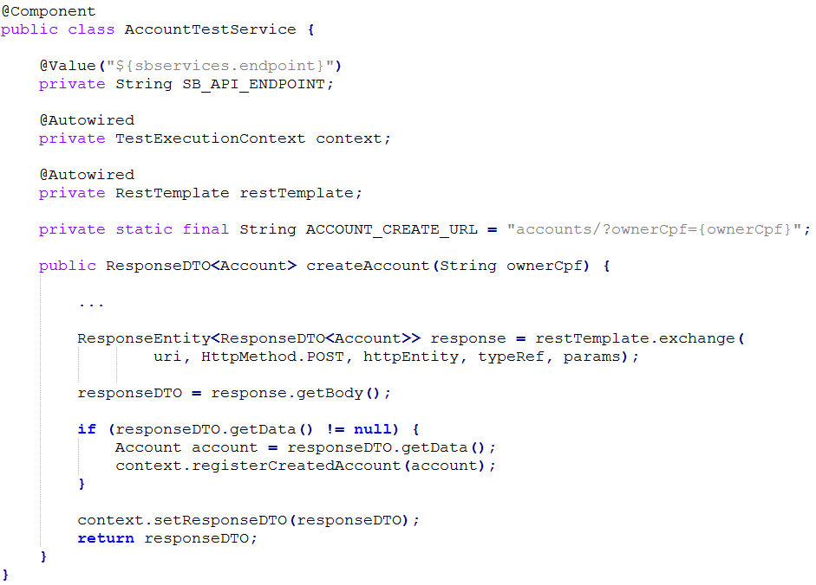
Test Service Objects
Notes:
Content Slide: This is usually the most frequently used slide in every presentation.
Use this slide for Text heavy slides. Text can only be used in bullet points
Title Heading – font size 30, Arial Heading
Slide Content – Should not reduce beyond Arial body font 16
If you need to use sub bullets please use the indent buttons located next to the bullets buttons in the tool bar and this will automatically provide you with the second, third, fourth & fifth level bullet styles and font sizes
Please note you can also press the tab key to create the different levels of bulleted content

Slide 43
DTO/Domain Objects
A data transfer object is an object that carries data between processes.
A DTO object aggregates the data that would have been transferred by the several calls,
public class Account {
private String ownerCpf;
private BigDecimas balance;
public void Account (String ownerCpf) {
this.ownerCpf = ownerCpf;
this.balance = BigDecimal.ZERO.setScale(2, RoundingMode.HALF_EVEN);
}
public String getOwnerCpf () {
return cpfOwner;
}
public void setBalance (BigDecimal value)
balance = balance.add(value);
}
public BigDecimal getBalance (BigDecimal value)
return balance ;
}
}
Notes:
Column content slide
This is a slide with 2 columns and you can have text in bullet points under each column. You can have separate header for each of the columns in the blue box provided on top of each of the columns.
Heading font size of the column should remain at 30 and the column content font size should not reduce beyond 16.

Slide 44
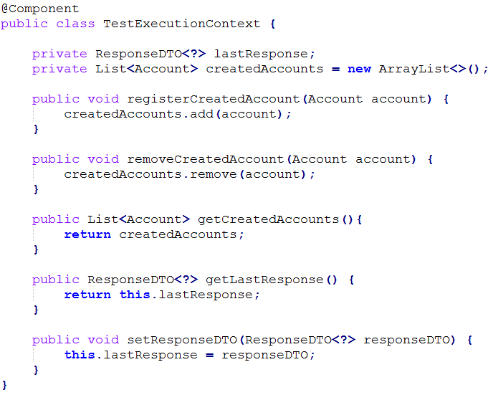
Context
Plain Java objects that help to store data that need to be shared between steps or steps classes.
They store information during the test runtime and normally are cleaned after scenario/story.
Notes:
Column content slide
This is a slide with 2 columns and you can have text in bullet points under each column. You can have separate header for each of the columns in the blue box provided on top of each of the columns.
Heading font size of the column should remain at 30 and the column content font size should not reduce beyond 16.

Slide 45
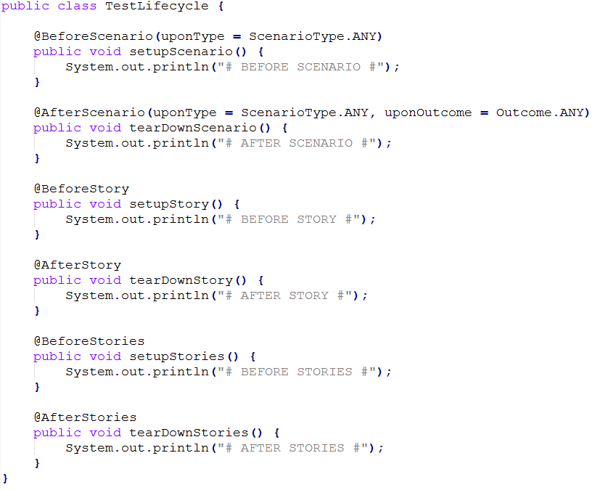
Jbehave Lifecycle
@BeforeScenario
@AfterScenario
@BeforeStory
@AfterStory
@BeforeStories
@AfterStories
Notes:
Column content slide
This is a slide with 2 columns and you can have text in bullet points under each column. You can have separate header for each of the columns in the blue box provided on top of each of the columns.
Heading font size of the column should remain at 30 and the column content font size should not reduce beyond 16.

Slide 46
Jbehave Lifecycle
ScenarioType:
Normal: Scenarios that don’t have Examples Table.
Example: Scenarios that have Examples Table.
Any: Any of above scenario types.
Outcome:
Success: Executed if the scenario has successfully executed.
Failure: Executed if the scenario has failed.
Any: Any of above outcomes.
Notes:
Column content slide
This is a slide with 2 columns and you can have text in bullet points under each column. You can have separate header for each of the columns in the blue box provided on top of each of the columns.
Heading font size of the column should remain at 30 and the column content font size should not reduce beyond 16.

Slide 47
Hands-on
Complete the exercise 2
Notes:
Content Slide: This is usually the most frequently used slide in every presentation.
Use this slide for Text heavy slides. Text can only be used in bullet points
Title Heading – font size 30, Arial Heading
Slide Content – Should not reduce beyond Arial body font 16
If you need to use sub bullets please use the indent buttons located next to the bullets buttons in the tool bar and this will automatically provide you with the second, third, fourth & fifth level bullet styles and font sizes
Please note you can also press the tab key to create the different levels of bulleted content

Slide 48
Front-End Testing

Slide 49
Front-end Testing
For web front-end testing purposes, we will have to use a tool that can automate the user actions through the browser interface: Selenium
Notes:
Content Slide: This is usually the most frequently used slide in every presentation.
Use this slide for Text heavy slides. Text can only be used in bullet points
Title Heading – font size 30, Arial Heading
Slide Content – Should not reduce beyond Arial body font 16
If you need to use sub bullets please use the indent buttons located next to the bullets buttons in the tool bar and this will automatically provide you with the second, third, fourth & fifth level bullet styles and font sizes
Please note you can also press the tab key to create the different levels of bulleted content

Slide 50


Selenium
Tool to automate browser.
Designed for testing purposes.
Can be used to automate even web-based administration tasks.
Has support for many browsers.
Notes:
Content Slide: This is usually the most frequently used slide in every presentation.
Use this slide for Text heavy slides. Text can only be used in bullet points
Title Heading – font size 30, Arial Heading
Slide Content – Should not reduce beyond Arial body font 16
If you need to use sub bullets please use the indent buttons located next to the bullets buttons in the tool bar and this will automatically provide you with the second, third, fourth & fifth level bullet styles and font sizes
Please note you can also press the tab key to create the different levels of bulleted content

Slide 51
Selenium WebDriver API
Collection of methods to interact with a browser.
Drives a browser natively as a real user.
Makes direct calls to the browser using each browser’s native support for automation.
Implementations:
ChromeDriver
FirefoxDriver
InternetExplorerDriver
...
Notes:
Content Slide: This is usually the most frequently used slide in every presentation.
Use this slide for Text heavy slides. Text can only be used in bullet points
Title Heading – font size 30, Arial Heading
Slide Content – Should not reduce beyond Arial body font 16
If you need to use sub bullets please use the indent buttons located next to the bullets buttons in the tool bar and this will automatically provide you with the second, third, fourth & fifth level bullet styles and font sizes
Please note you can also press the tab key to create the different levels of bulleted content

Slide 52
Selenium WebDriver API
Using WebDriver you can:
Navigate
Search for HTML/DOM elements in the page using some criteria (css class, id, name, xpath, etc)
Get HTML elements attributes/properties
Trigger elements actions (type, click, double click, select, etc)
Manage the browser (delete cookies, set a proxy, etc)
Notes:
Content Slide: This is usually the most frequently used slide in every presentation.
Use this slide for Text heavy slides. Text can only be used in bullet points
Title Heading – font size 30, Arial Heading
Slide Content – Should not reduce beyond Arial body font 16
If you need to use sub bullets please use the indent buttons located next to the bullets buttons in the tool bar and this will automatically provide you with the second, third, fourth & fifth level bullet styles and font sizes
Please note you can also press the tab key to create the different levels of bulleted content

Slide 53
Selenium WebDriver API
Example:
WebElement input = driver.findElement(By.tagName(“input"));
input.sendKeys(“Sample Test”);
WebElement button = driver.findElement(By.className(“gwt-button”));
if ( button.isDisplayed() && button.isEnabled() ) {
button.click();
}
Notes:
Content Slide: This is usually the most frequently used slide in every presentation.
Use this slide for Text heavy slides. Text can only be used in bullet points
Title Heading – font size 30, Arial Heading
Slide Content – Should not reduce beyond Arial body font 16
If you need to use sub bullets please use the indent buttons located next to the bullets buttons in the tool bar and this will automatically provide you with the second, third, fourth & fifth level bullet styles and font sizes
Please note you can also press the tab key to create the different levels of bulleted content

Slide 54
Page Objects
Within your web app's UI there are areas that your tests interact with.
A Page Object simply models these as objects within the test code.
This reduces the amount of duplicated code and means that if the UI changes, the fix need only be applied in one place.
Notes:
Content Slide: This is usually the most frequently used slide in every presentation.
Use this slide for Text heavy slides. Text can only be used in bullet points
Title Heading – font size 30, Arial Heading
Slide Content – Should not reduce beyond Arial body font 16
If you need to use sub bullets please use the indent buttons located next to the bullets buttons in the tool bar and this will automatically provide you with the second, third, fourth & fifth level bullet styles and font sizes
Please note you can also press the tab key to create the different levels of bulleted content

Slide 55
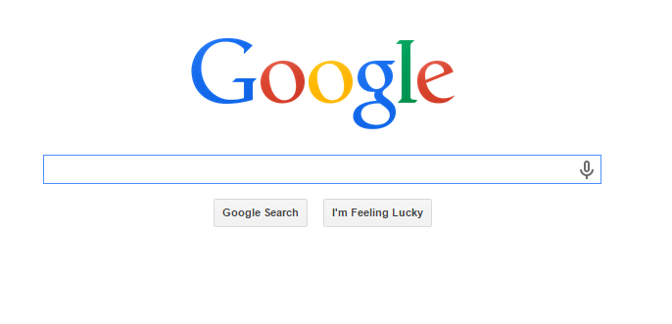
Page Objects
Image
Input
Button
Button
Notes:
Content Slide: This is usually the most frequently used slide in every presentation.
Use this slide for Text heavy slides. Text can only be used in bullet points
Title Heading – font size 30, Arial Heading
Slide Content – Should not reduce beyond Arial body font 16
If you need to use sub bullets please use the indent buttons located next to the bullets buttons in the tool bar and this will automatically provide you with the second, third, fourth & fifth level bullet styles and font sizes
Please note you can also press the tab key to create the different levels of bulleted content

Slide 56

Page Objects
@PageObject
public class GoogleSearchPage {
@FindBy(how = How.ID, using = “lst-ib”)
private WebElement inputSearch;
@FindBy(how = How.NAME, using = “btnK”)
private WebElement btnSearch;
public GoogleSearchPage search (String textToSearch){
inputSearch.sendKeys(textToSearch);
btnSearch .click();
return this;
}
}
Notes:
Content Slide: This is usually the most frequently used slide in every presentation.
Use this slide for Text heavy slides. Text can only be used in bullet points
Title Heading – font size 30, Arial Heading
Slide Content – Should not reduce beyond Arial body font 16
If you need to use sub bullets please use the indent buttons located next to the bullets buttons in the tool bar and this will automatically provide you with the second, third, fourth & fifth level bullet styles and font sizes
Please note you can also press the tab key to create the different levels of bulleted content

Slide 57
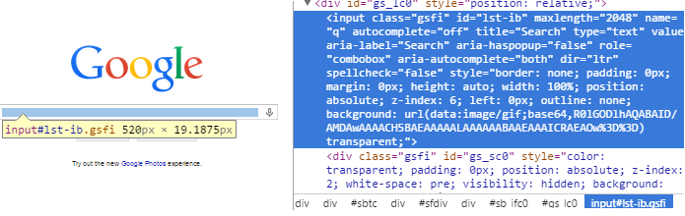
How to find Elements?
@FindBy parameters:
how: ID
using: “lst-ib”
Notes:
Content Slide: This is usually the most frequently used slide in every presentation.
Use this slide for Text heavy slides. Text can only be used in bullet points
Title Heading – font size 30, Arial Heading
Slide Content – Should not reduce beyond Arial body font 16
If you need to use sub bullets please use the indent buttons located next to the bullets buttons in the tool bar and this will automatically provide you with the second, third, fourth & fifth level bullet styles and font sizes
Please note you can also press the tab key to create the different levels of bulleted content

Slide 58
Exercise 4
Following the best practices, now we have to change the FE test project to use PageObjects instead of making calls to the webdriver directly inside the test methods.
Complete the scenario adding a step to test the logout link.
Notes:
Content Slide: This is usually the most frequently used slide in every presentation.
Use this slide for Text heavy slides. Text can only be used in bullet points
Title Heading – font size 30, Arial Heading
Slide Content – Should not reduce beyond Arial body font 16
If you need to use sub bullets please use the indent buttons located next to the bullets buttons in the tool bar and this will automatically provide you with the second, third, fourth & fifth level bullet styles and font sizes
Please note you can also press the tab key to create the different levels of bulleted content

Slide 59
Exercise 4 - Tips
You should change the existent scenario and create a PageObject to represent for instance, the index page.
In your page object you will have methods to represent the possible actions in the page.
Notes:
Content Slide: This is usually the most frequently used slide in every presentation.
Use this slide for Text heavy slides. Text can only be used in bullet points
Title Heading – font size 30, Arial Heading
Slide Content – Should not reduce beyond Arial body font 16
If you need to use sub bullets please use the indent buttons located next to the bullets buttons in the tool bar and this will automatically provide you with the second, third, fourth & fifth level bullet styles and font sizes
Please note you can also press the tab key to create the different levels of bulleted content

Slide 60
Leonardo Araujo Santos
Felipe Carvalho
29/05/2017

